Slide 1
TITLE: Stock Stream
Mini Project(21ISMP67) Presentation –(2023-2024)
Batch No:- 17
Project Team Members:
Anmol Shubham 1AY21IS016
Ahzam Saba 1AY21IS007
Amod Kumar 1AY21IS012
Manaswi Kumar 1AY21IS051
Under the Guidance of
Prof. Mary M Dsouza
Assistant Professor
Department of ISE
Acharya Institute Of Technology
1

Slide 2
Agenda
2
Abstract
Introduction
Problem Statement
Requirement Specification(Hardware & Software)
System Design ( Data Flow Diagram and Flow Charts or Class Diagram or Use Case Diagram or Activity diagram)
7. Implementation (All Modules)
8. Testing
9. Test Cases
10. Results(Snapshots)
11. Future Enhancements
12. Conclusion
13. References

Slide 3
Abstract
In the rapidly evolving financial markets, accurate stock price prediction is a crucial tool for investors and traders. This project presents a stock prediction application developed using Streamlit and Facebook Prophet, aimed at providing users with reliable and actionable forecasts of stock prices. The application leverages historical stock data to predict future trends, offering an intuitive and user-friendly interface for both novice and experienced users.
Streamlit, a powerful framework for building interactive web applications, was used to develop the front-end of the application. It enables real-time data visualization and interaction, making the prediction process transparent and comprehensible. On the back-end, Facebook Prophet, a robust forecasting tool developed by Facebook, was employed. Prophet is designed to handle time series data with daily observations and to accommodate seasonality, holidays, and other structural components of time series data, making it an ideal choice for stock price prediction.
3

Slide 4
INTRODUCTION
In the volatile and fast-paced environment of financial markets, the ability to predict stock price movements is invaluable. Accurate stock predictions can significantly aid investors and traders in making informed decisions, thereby optimizing their investment strategies and maximizing returns. However, predicting stock prices is a complex task that requires advanced tools and techniques.
To address this challenge, we developed a stock prediction application utilizing Streamlit and Facebook Prophet. This project combines the strengths of modern web development frameworks with sophisticated forecasting algorithms to create a powerful and user-friendly tool for stock market analysis.
Key Objectives:
Enhance Accessibility: Provide an intuitive interface that allows users, regardless of their technical expertise, to easily access and interpret stock predictions.
Leverage Advanced Forecasting: Utilize Facebook Prophet's capabilities to generate reliable and precise stock price forecasts, taking into account historical data, seasonality, and other relevant factors.
Facilitate Informed Decisions: Equip users with actionable insights through clear and interactive visualizations of predicted stock trends and confidence intervals.

Slide 5
PROBLEM STATEMENT
Problem Statement:
In the highly volatile and complex world of financial markets, predicting stock prices accurately remains a significant challenge. Investors and traders often struggle with making informed decisions due to the unpredictable nature of stock price movements, influenced by a myriad of factors such as market trends, economic indicators, and global events. Traditional methods of stock analysis can be time-consuming and may not provide the level of accuracy required for effective decision-making.

Slide 6
REQUIREMENT SPECIFICATION
Hardware Requirements:
Processor: Any modern multi-core processor (e.g., Intel Core i5 or AMD Ryzen 5).
Memory: Minimum 8 GB RAM, ideally 16 GB or more for smoother performance with large datasets.
Storage: SSD storage is recommended for faster data access.
Graphics: Integrated graphics are sufficient for plotting and visualization tasks unless using GPU-intensive operations.
Software Requirements:
Operating System: Windows11 or 10, macOS, or Linux.
Python: Version 3.6 or higher.
Libraries: Ensure the following libraries are installed:
Streamlit
Pandas
Plotly
yfinance
Prophet
datetime

Slide 7
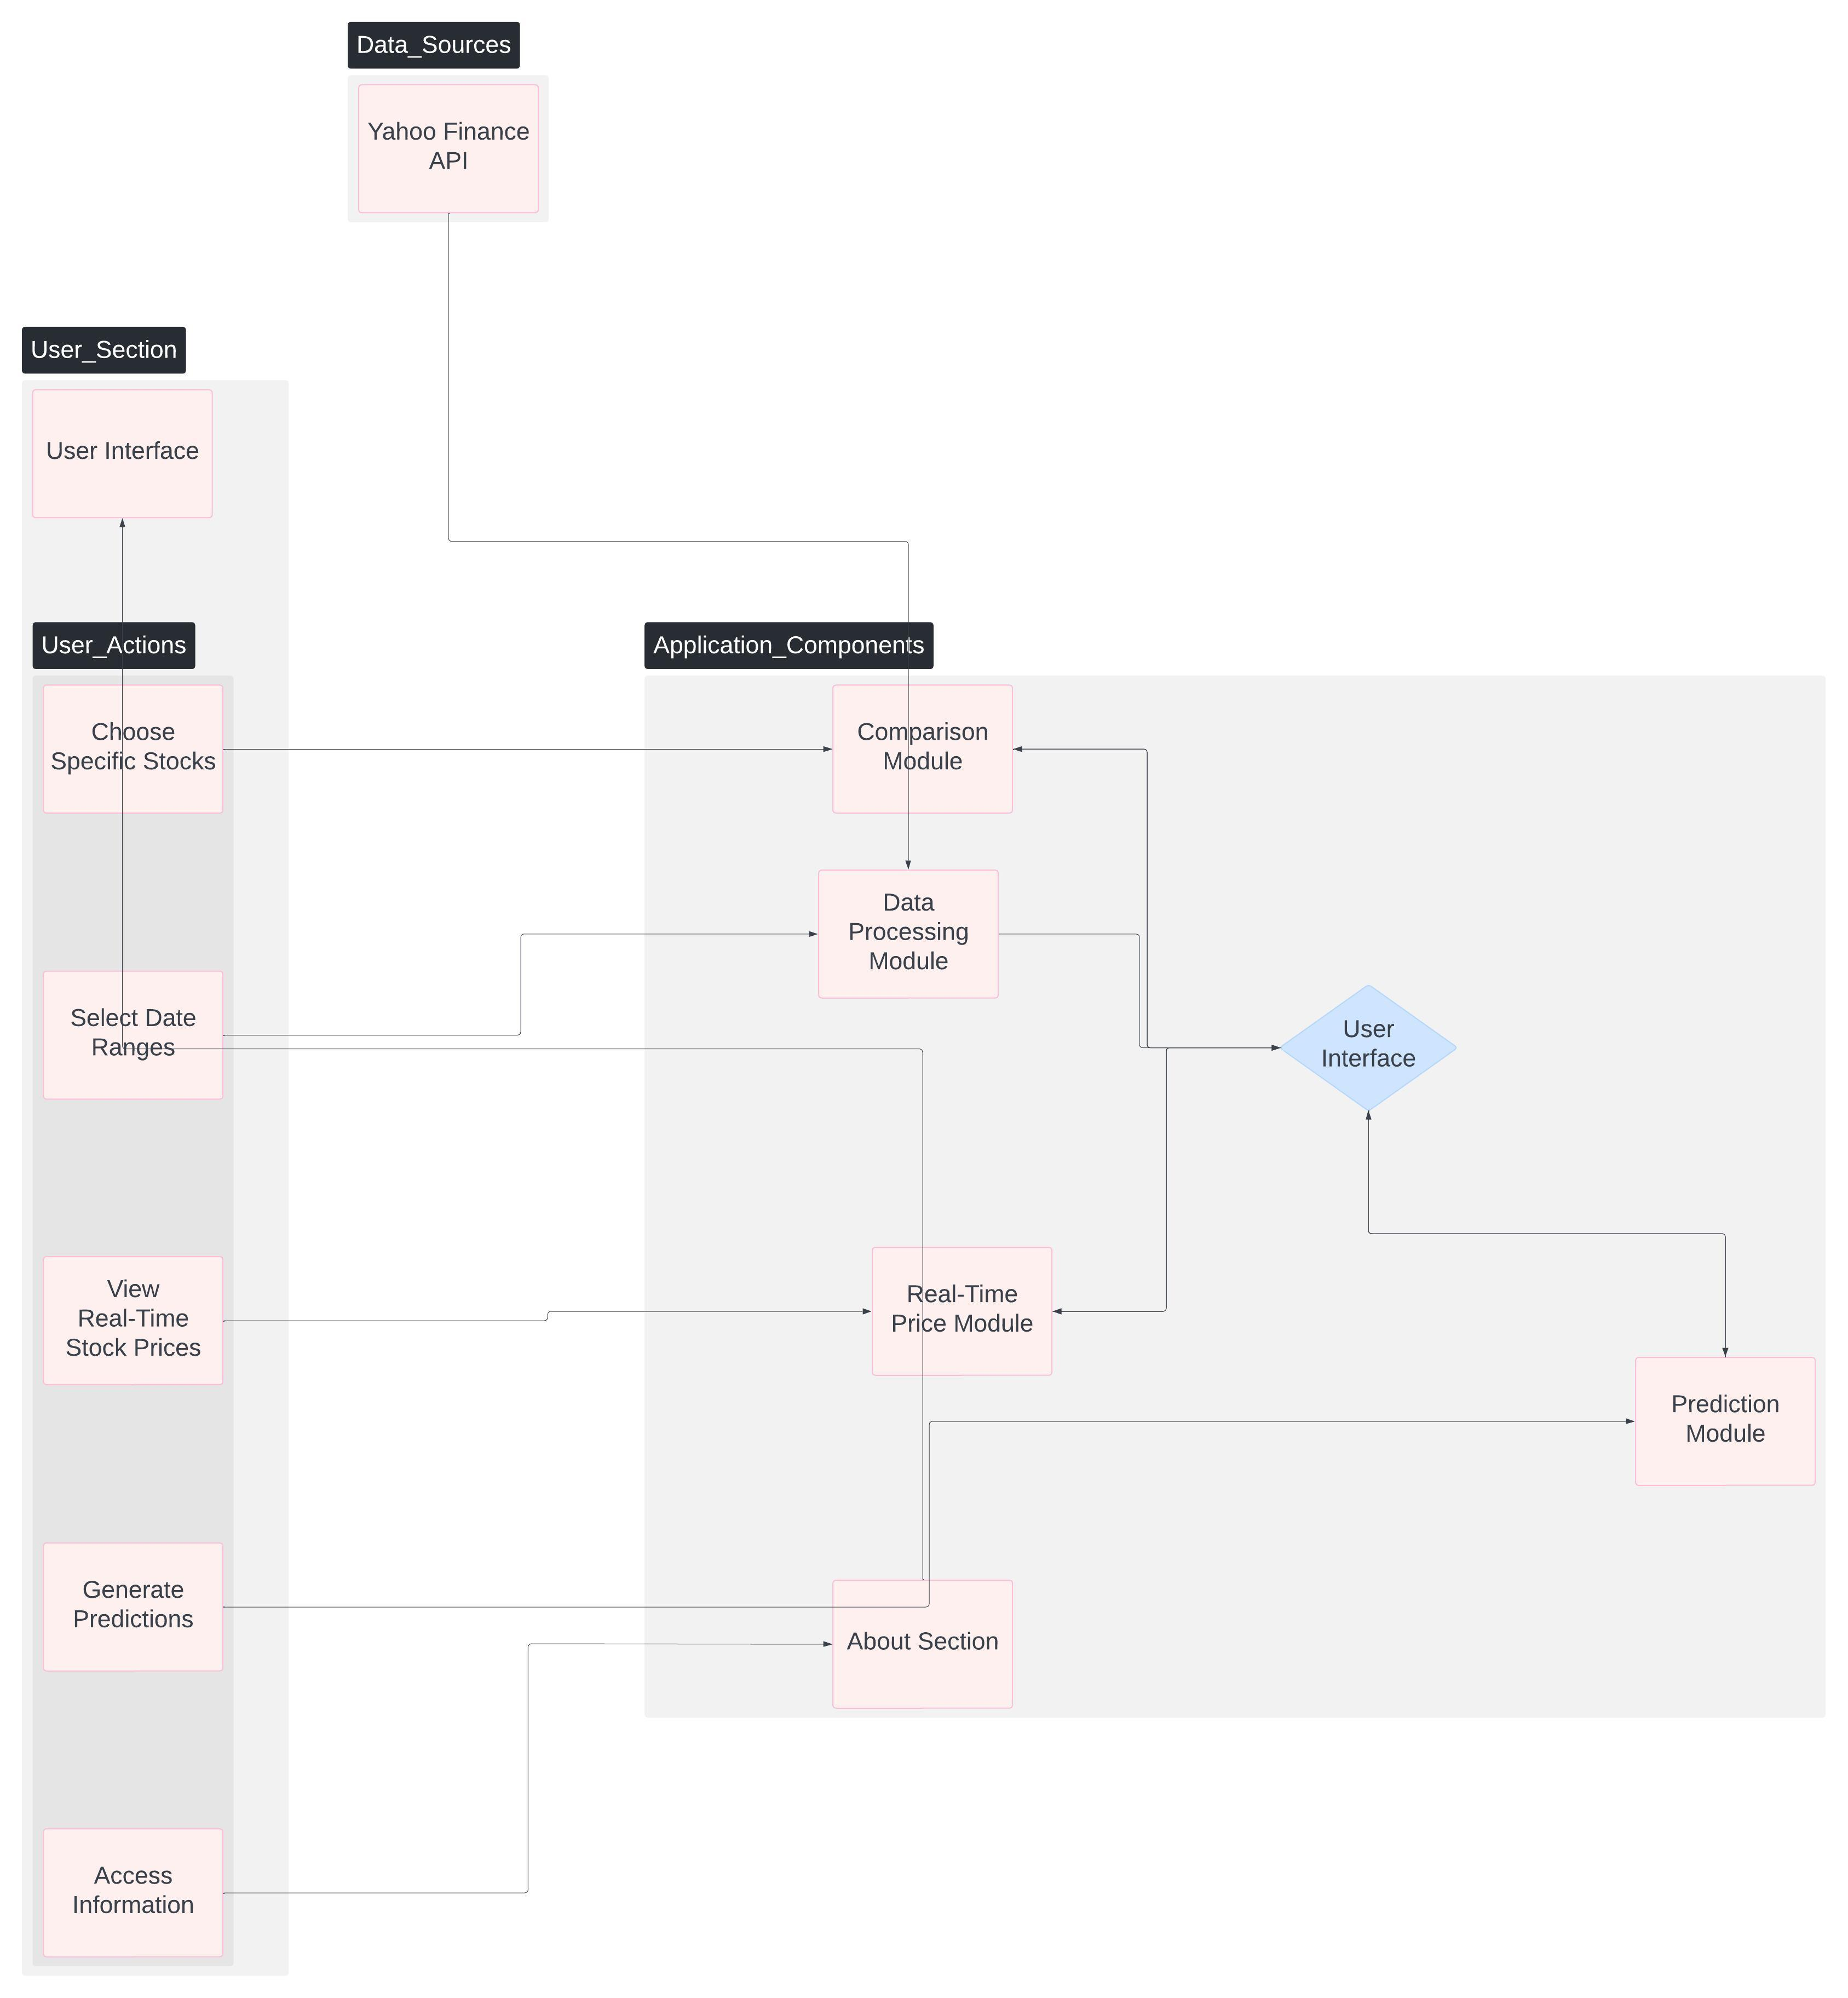
SYSTEM DESIGN
Data Flow Diagram

Slide 8
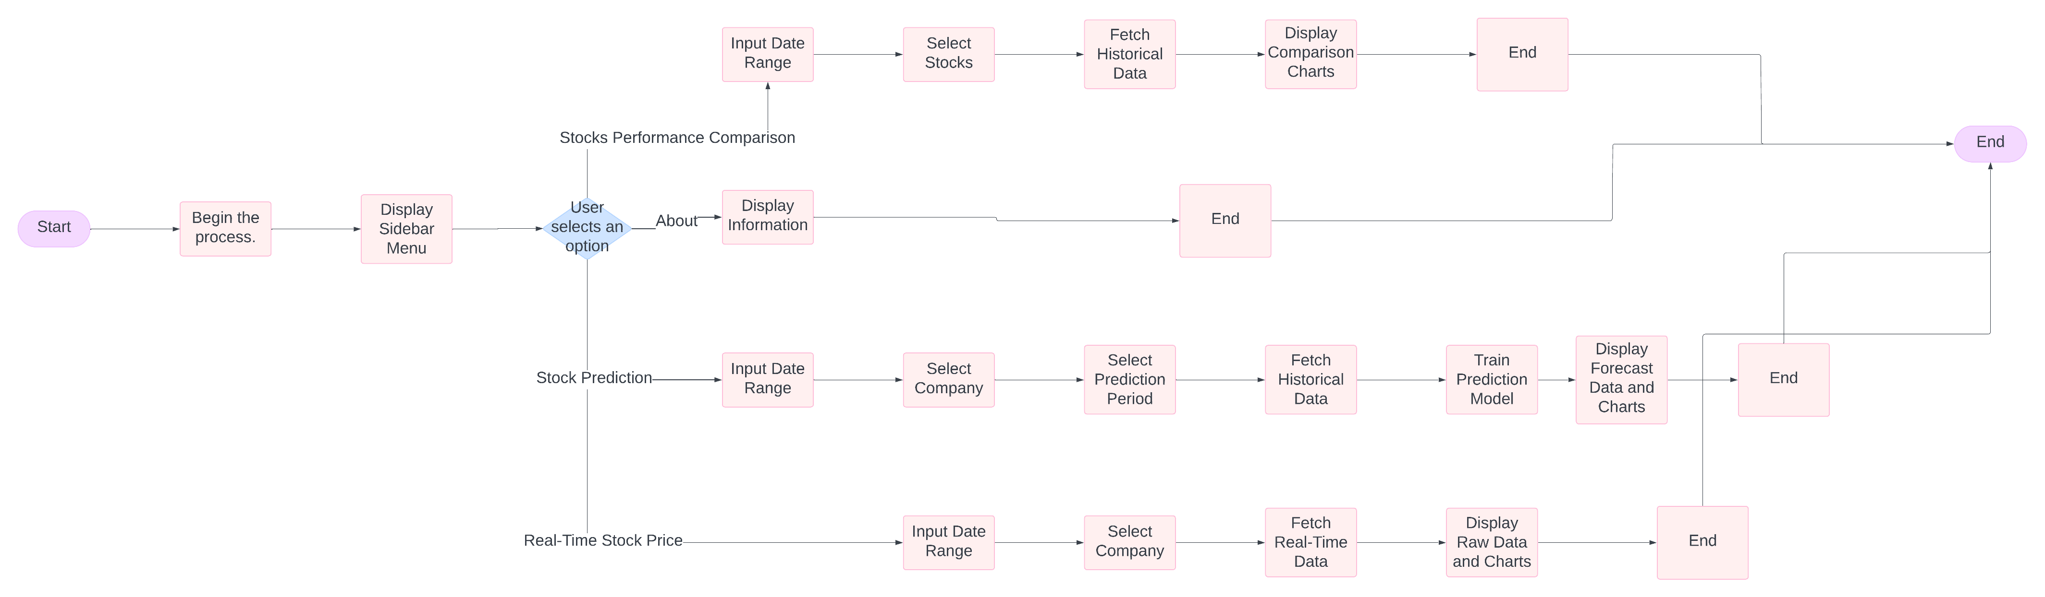
Flow Chart

Slide 9
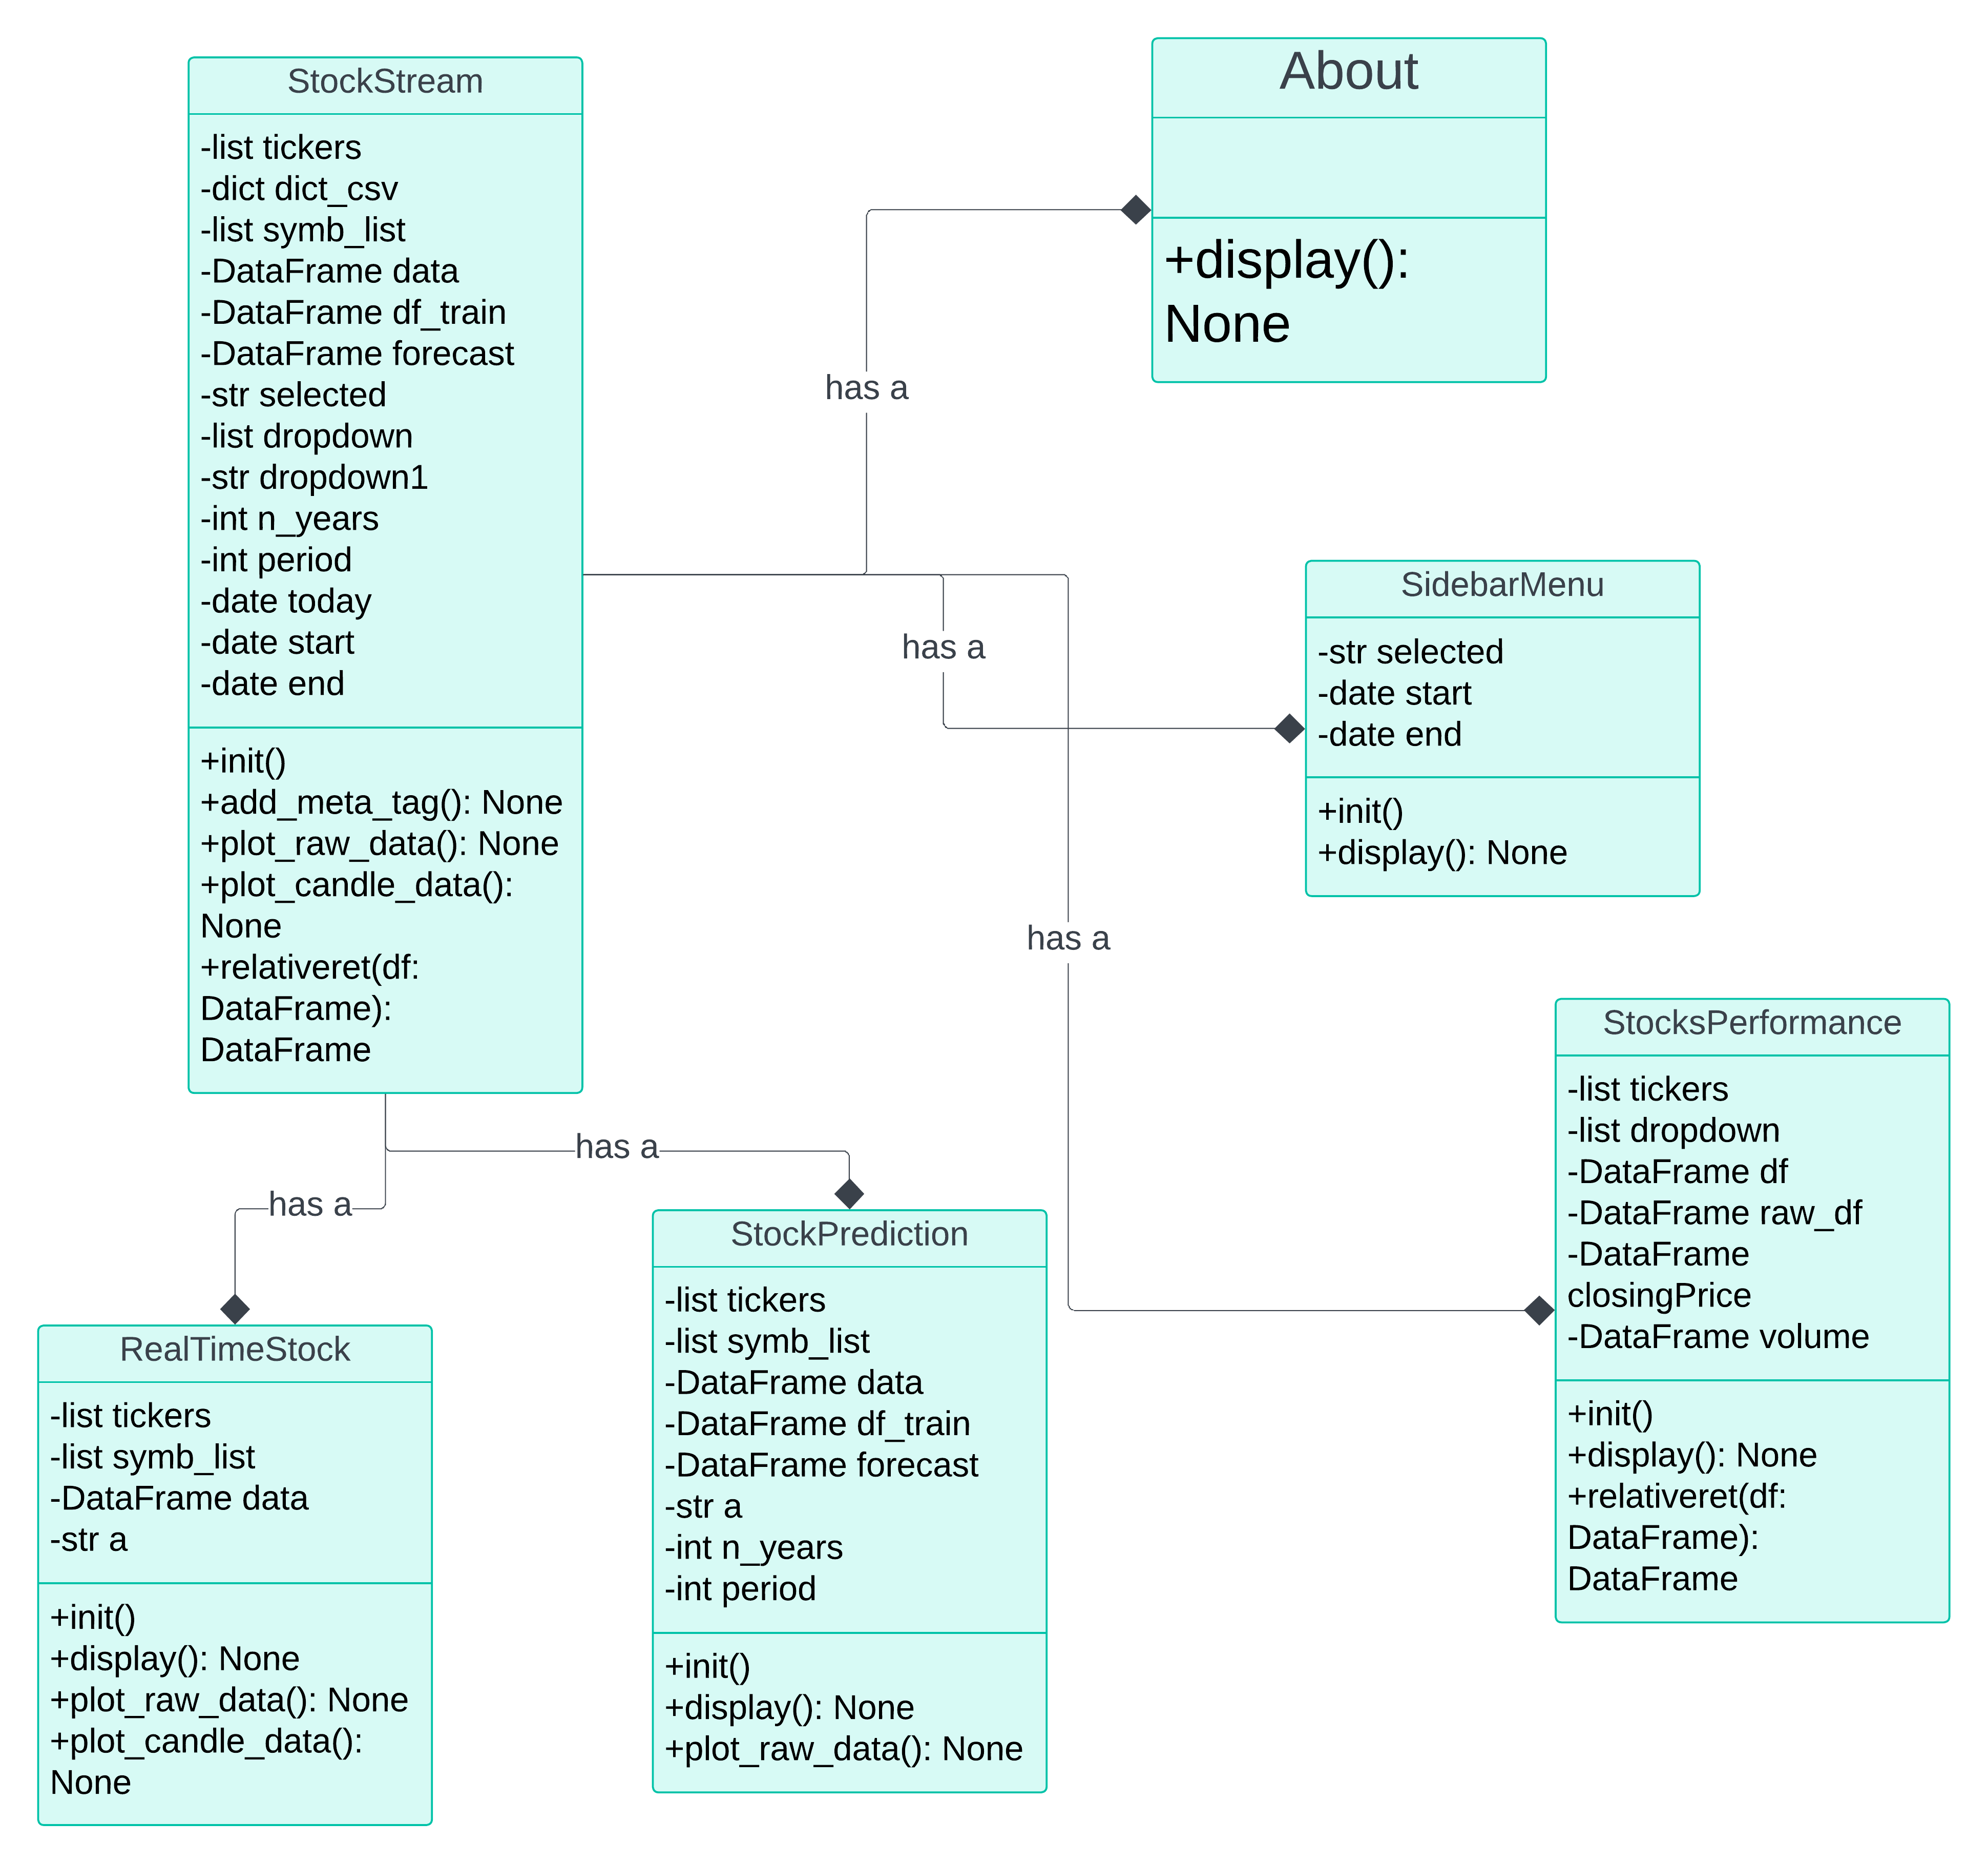
Class Diagram

Slide 10
IMPLEMENTATION
1. Planning and Setup:
Define Requirements:
Determine the core features of the weather app (current weather, forecast, location-based services, etc.).
Decide on additional features such as user preferences (e.g., temperature units), error handling, and responsiveness.
Technology Stack:
Frontend: HTML, CSS, JavaScript
API: Yfinace Api

Slide 11
2. Development:
UI/UX Design: Create wireframes and mockups to plan the user interface.
Component Implementation: Develop components for displaying current weather, forecasts, settings/preferences, etc.
API Integration: Integrate with weather APIs to fetch weather data based on user inputs.
3. Implementation Details:
Fetching Weather Data:
Use AJAX or Fetch API in JavaScript to make HTTP requests to the weather API.
Handle API responses, parse JSON data, and display relevant weather information on the frontend.

Slide 12
User Interface:
Design a responsive and user-friendly interface using CSS frameworks like Bootstrap or custom CSS.
Ensure accessibility standards are met for users with disabilities.
Error Handling:
Implement error handling for scenarios like invalid user inputs, API request failures, or network issues.
Provide user-friendly error messages and options for users to retry or provide alternative inputs.
4. Deployment:
Choose a hosting provider (e.g., AWS, Heroku, Netlify) based on scalability, cost, and deployment requirements.

Slide 13
TESTING
We did UI testing to ensure the following:
Visual appearance: Confirming that the UI elements (text, icons, layout) are displayed correctly and according to design specifications.
Functionality: Testing if features like location search, geolocation, and weather data display work as expected.
Responsiveness: Verifying if the UI layout adapts appropriately for different screen sizes and devices (desktops, tablets, smartphones).
Usability: Evaluating if the UI is easy to navigate and understand for users with varying levels of technical expertise.

Slide 14
TEST CASES
Unit Testing
Test Case ID | Description | Input | Expected Output | Status
UT-01 | Test relative return calculation | Stock data | Correct calculation of relative return | Pass
UT-02 | Test data download from yFinance | Ticker symbol, start date, end date | Data frame with correct stock data | Pass
UT-03 | Test data plot for line chart | Stock data | Line chart with correct data points | Pass
UT-04 | Test stock price prediction with Prophet | Historical stock data | Data frame with predicted stock prices | Pass
UT-05 | Test data upload and read from CSV | CSV file with stock data | Correctly read data frame | Pass

Slide 15
TEST CASES
Integration Testing
Test Case ID | Description | Modules Involved | Expected Output | Status
IT-01 | Integration of data download and plotting | yFinance API, Plotly | Accurate plot with downloaded stock data | Pass
IT-02 | Integration of sidebar selection and data | Streamlit sidebar, yFinance API, Data processing | Correct data displayed based on sidebar selection | Pass
IT-03 | Integration of prediction model and plotting | Prophet, Plotly, yFinance API | Accurate prediction plot for selected stock | Pass
IT-04 | Integration of stock comparison feature | yFinance API, Data processing, Plotly | Correct comparison chart for selected stocks | Pass

Slide 16
TEST CASES
System Testing
Test Case ID | Description | Scenario | Expected Output | Status
ST-01 | Full system test for stock comparison | User selects multiple stocks and time range | Display comparison chart with correct data | Pass
ST-02 | Full system test for real-time prices | User selects a stock and views real-time price | Display real-time price with correct data | Pass
ST-03 | Full system test for stock prediction | User selects a stock and time range for prediction | Display predicted stock prices with correct forecast data | Pass
ST-04 | System response to invalid inputs | User selects invalid date range or stock ticker | Display appropriate error message and no data | Pass
ST-05 | System usability and performance | User interacts with all features of the app | Smooth and responsive interface without crashes or delays | Pass

Slide 17
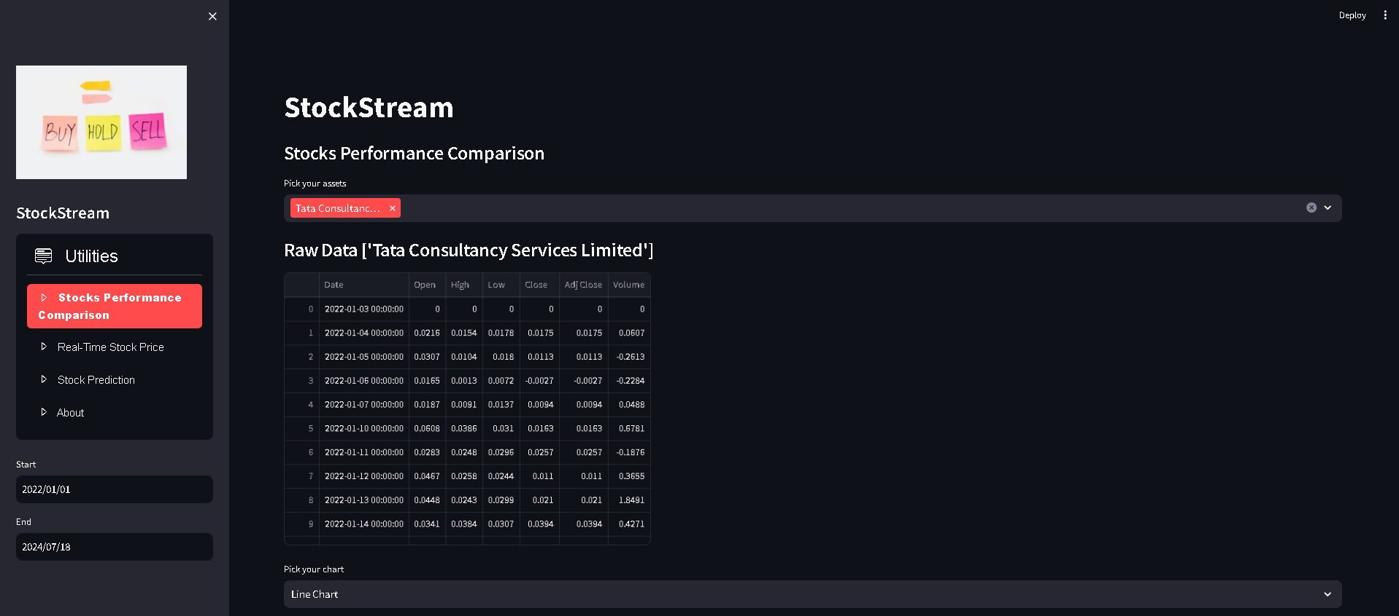
RESULTS

Slide 18
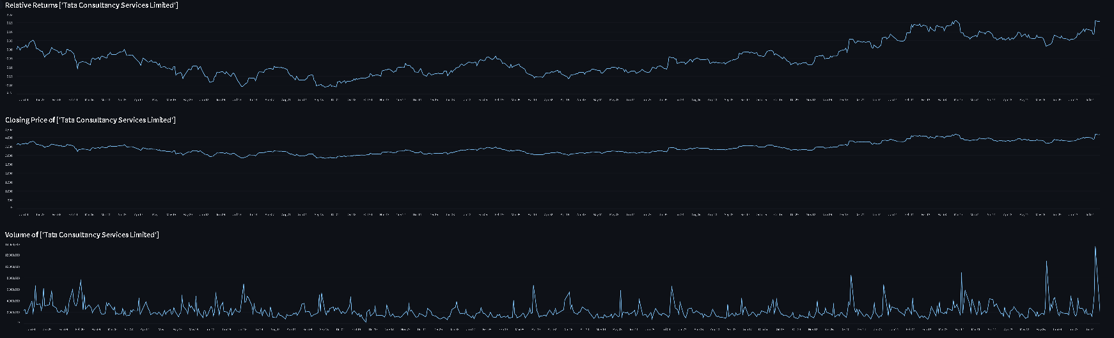

Slide 19
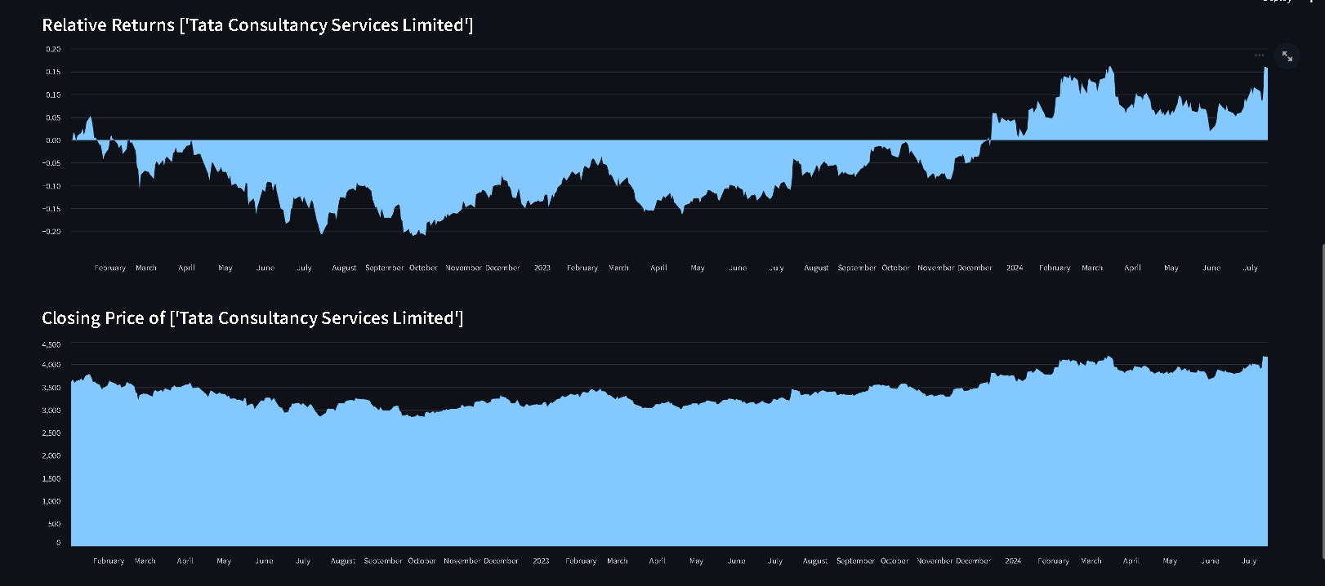

Slide 20
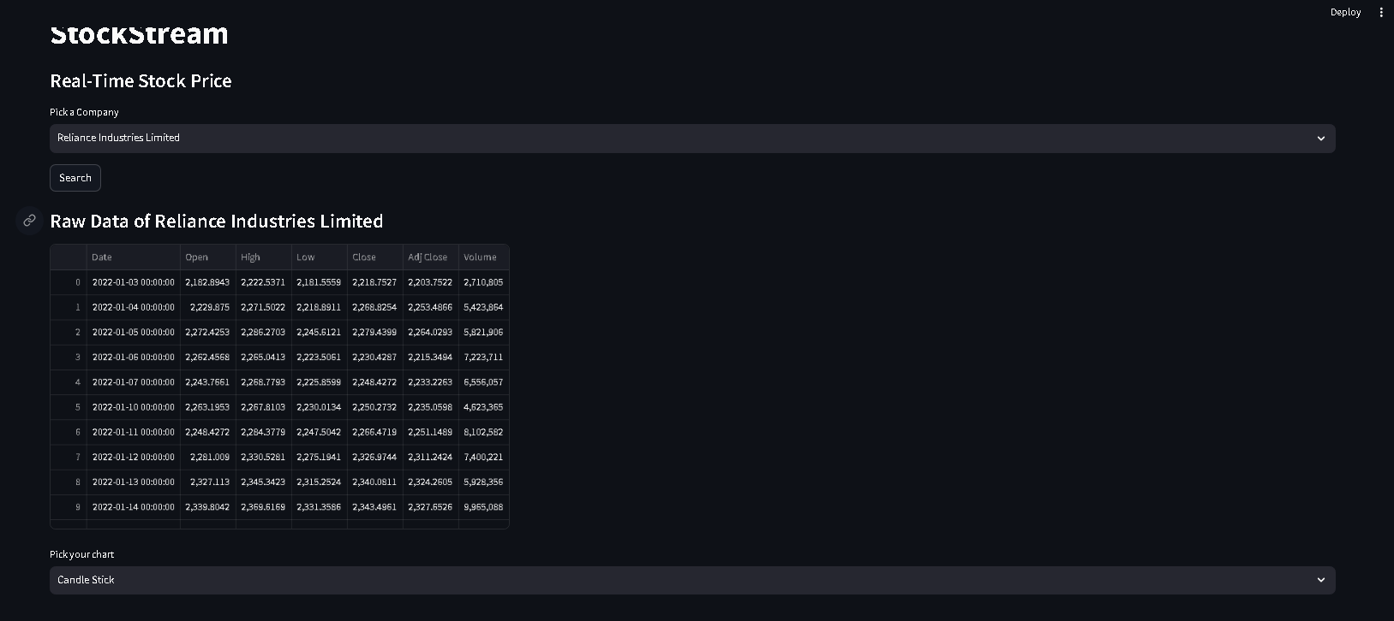

Slide 21
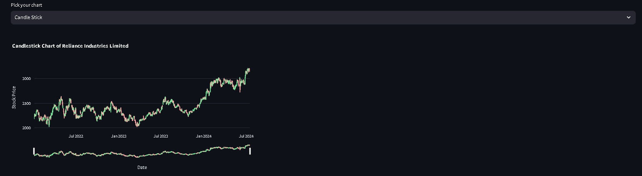

Slide 22
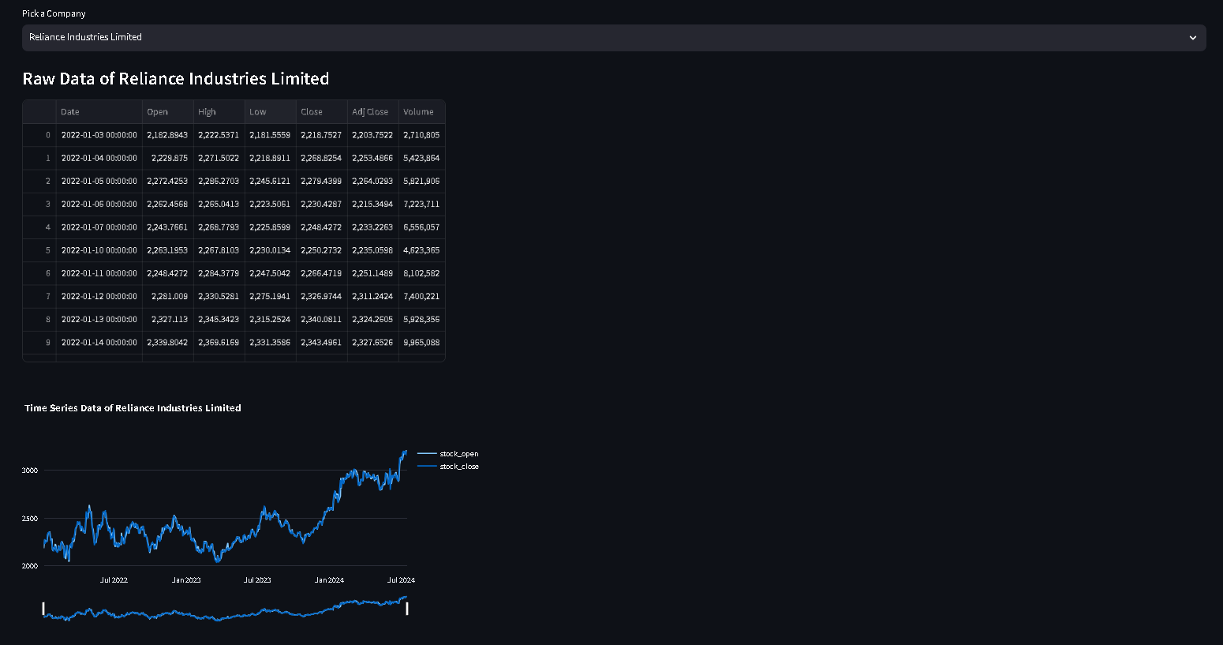

Slide 23
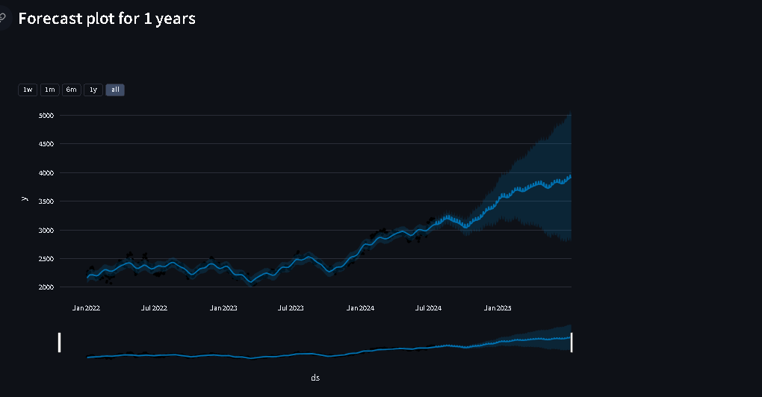

Slide 24
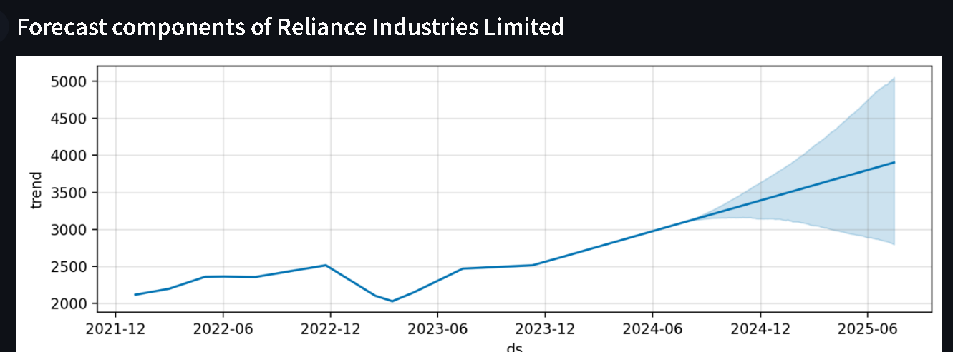

Slide 25
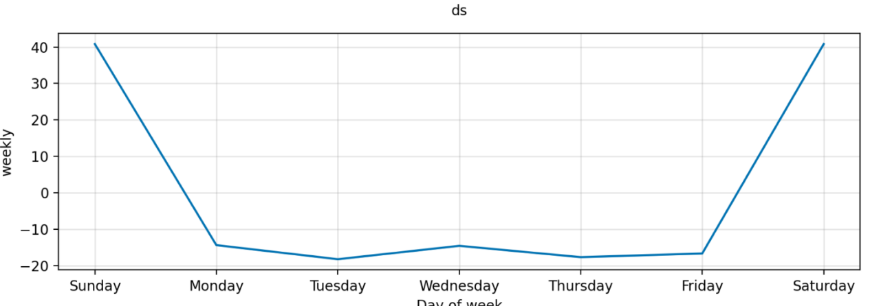

Slide 26
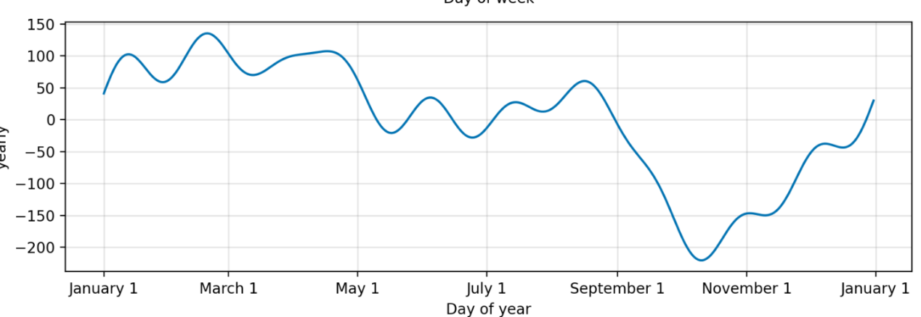

Slide 27
FUTURE ENHANCEMENTS
User Authentication and Profiles
Advanced Visualization Options:
Real-Time Alert
Machine Learning Model Integration
Enhanced Data Insights
Mobile Optimization
Performance Optimization and Scalability
Social Sharing and Collaboration

Slide 28
CONCLUSION
StockStream is a dynamic web application developed by Anmol Shubham, Amod Kumar, Ahzam Saba, Manaswi Kumar, and Rohit More using Streamlit. It provides users with intuitive tools for stock market analysis and prediction, featuring capabilities like stock performance comparisons, real-time price updates, and future price forecasting using Prophet. Future enhancements include user authentication, advanced visualizations, real-time alerts, machine learning integration, social sharing, mobile optimization, expanded data sources, and improved performance. These improvements aim to elevate StockStream as a robust platform for informed decision-making and financial analysis.

Slide 29
References
Yahoo Finance: https://finance.yahoo.com/
Medium : https://medium.com/srm-mic/its-time-to-talk-about-time-series-forecasting-math-edition-c7c915761ad4
Kaggle:https://www.kaggle.com/
Mathematics Stack Exchange:https://math.stackexchange.com/
MIT OpenCourseWare - Mathematics : https://ocw.mit.edu/courses/mathematics/

Slide 30

12

Slide 31
13

